Slide 1
Please Help Jamaica Empower Our Survivors of Sexual Abuse and Sexual Exploitation
By Sponsoring
A Healing Intervention

Slide 2
The Starting Point
The best approach to addressing life’s most momentous problems is to:
Examine the problem
Explore the alternatives
Choose the right alternative
Act

Slide 3
Act by making therapy for a person recovering from childhood sexual abuse in Jamaica possible

Slide 4
Sexually Abused or Sexually Exploited individuals walk through our doors everyday. They want to engage in recovery therapy but have no means to pay not even for the bus fare to return home.

Slide 5
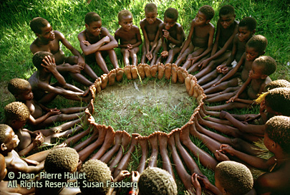
Can We Help This Situation Together?

Slide 6
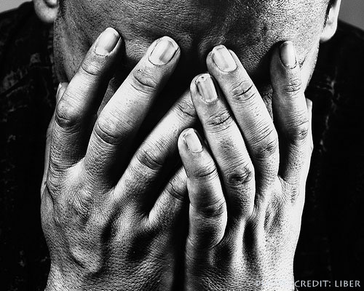
Examining The Problem
Jamaica is ranked #6 in the world for the number of children sexually abused for every 1000 persons in the population
The United Nations estimates, and local researchers concur, that only about one in ten sexual offences such as rape are ever reported.

Slide 7
Examining The Problem
78% of Sexually Abused patients referred to the health facilities of Jamaica in 2006 were children.
86% of Sexual Abuse against children is committed by someone that is a family member or known by the child.

Slide 8
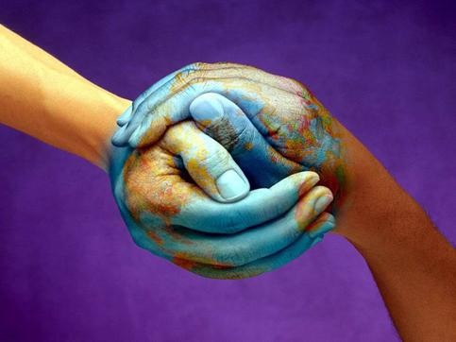
Examining The Global Problem
Globally 150 million girls report being sexually abused annually.
Globally 73 million boys report being sexually abused annually

Slide 9
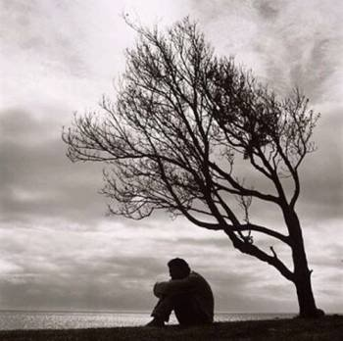
The Results On The Individual
Suicidal Preoccupation
Self Sabotaging Behavior
Psychosis
Severely Interrupted Personal Relationships
Avoidance and Difficulty in Attaining Intimacy
Sexual Dysfunction
Self Harming Behavior i.e. burning, cutting, and/or piercing of the skin

Slide 10
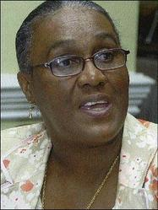
What Has Been Done?
Commendation has to be given to many Jamaican Children's Advocates and government and non -governmental agencies for the tremendous effort that they extend to address issues of Sexual Abuse.

Slide 11
What Is Being Done?
The first disclosure of sexual abuse may be to a friend or a non therapeutic professional. If they are informed they may refer the person to;
Centers for Sexual Offences and Child Abuse (C.S.O.C.A) Departments of the Jamaican Defense Force.(The Police). Their job is to catch the perpetrator.
The medical professionals (Doctors). Their job is to heal the physical scars. There is no time in their schedules for psychological work.

Slide 12
What Is Being Done?
Overburdened systems in Jamaica leave practically no time to do any therapeutic work.
Core sexual abuse issues and the healing of sexual abuse are often missed completely.

Slide 13
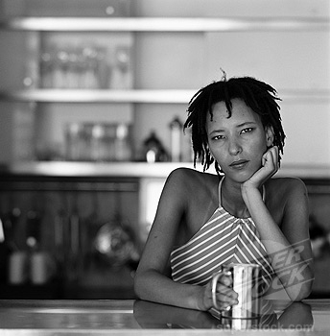
What Is Not Being Done?
The majority of Jamaican survivors may never share what has happened to them with specialized therapeutic professionals.
Therefore they have no means to break the cycle of abuse, they also have no access to healing!

Slide 14
What are the alternatives?
Alternative Two
Alternative One
Do it the way we have done it
Work with the existing systems
Give the existing staff more tasks
Utilize a multidimensional approach, a way which offers the appropriate time and opportunity to heal holistically.

Slide 15
Our Healing Intervention Multidimensional Approach Offers:
Structured psychotherapy, life coaching, sustainable wealth creation methods, meditation and movement momentum therapy for stress relief.
Cycle breaking strategies for the client and their children and following generations.
Education on the Psychology of Sexual Violence and Self Protection.

Slide 16
The Process
Referring Agency
or
Individual Makes Contact
Assessment
6 months of Group
&
Individual Therapy

Slide 17
Our Group Therapy Services
Focuses on our clients strengths and needs in a safe therapeutic environment.
Gives intense individual therapy.
Introduces clients in person, to a vetted eclectic body of Educational Consultants, Teachers, Social Workers, Holistic Therapists, Doctors, Counselors, Conflict Reduction Practitioners and Safety Consultants .

Slide 18
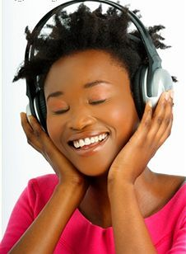
Our Therapy Groups
Our Therapy Groups in Jamaica have been offering structured healing to Women for the last three years. Women have had great success in reclaiming satisfying lives in just Six Months.

Slide 19
We are Healing Lives.
One of our clients
Prior to having therapy
Always had very
Argumentative,
Non committing,
Angry relationships
After a year on our
Program she is happily married

Slide 20
One of our young clients
Had been out of school
Prior to therapy
She suffered from
Arrested development
She had the learning age of 8 yrs She had a chronological age of 15
Two years ago
Our program got her back in school
She now has a reading age of 12
She is still at school
She fought & won
Her case against the rapists
She is still having therapy

Slide 21
What can you offer? How can you help? What part will you play ? We have four women ready and willing to heal their lives!

Slide 22
The Cost of Sponsoring A women for three months
Two Hundred and Thirty Pounds Sterling
Four Hundred U.S. Dollars
We know times are difficult any amount you send will be useful for our clients, you can be assured we will make best use of any sum you send.

Slide 23
What will your sponsorship offer the sexually abused person
Once per month they will receive four hours of group therapy intervention conducted by four different types of qualified Therapists & Social Work Practitioners.
A sumptuous meal at the therapy luncheon
A personally designed self help treatment program
An intensive individual session once per month.
Unlimited phone access to all four practitioners for the sponsored period

Slide 24
What will your sponsorship offer you
Peace of mind and the knowledge that you are making a significant difference to another human beings life.
Updates of your clients general progress.
Updates on the collective sponsorship initiative.

Slide 25
The Sponsorship Paying Process
Send via www.westernunion.com or via
High Street Western Unions.
Address to send:
Pure Potential at 15 Chellaston Drive, Mandeville, Manchester Jamaica
2. Email us at:
purepotential@live.com
3. Call us at:
876-476-1724
4. Inform us of:
Your name, address, telephone number & tracking number.

Slide 26
The Sponsorship Process
Once your sponsorship has been received
You will be informed
The Therapy Process Begins Immediately!
Our clients are ready to accept your support to heal!

Slide 27
REMEMBER:
You will be helping us stop the process of hurting!
Contact Us @ purepotential@live.com or 876-476-1724
876-625-8505
Thank you so much for your precious time.

